Slide 1
Concurrency: Deadlock
Dr. Probir Roy
Some slides are modified from
Dr. Shengquan Wang
Operating Systems: Three Easy Pieces, by Remzi H. Arpaci-Dusseau and Andrea C. Arpaci-Dusseau
Operating System Concepts, 8th edition, by Silberschatz, Galvin, Gagne, John Wiley & Sons, 2009
Notes:
1

Slide 3
How did Mark successfully communicate with NASA initially after the accident?
Through Pathfinder, which is real.

Slide 4
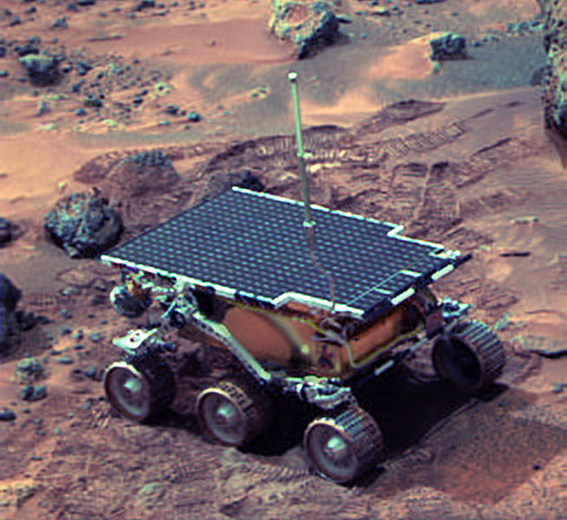
Mars Pathfinder
The rover landed successfully on Mars on July 4, 1997.
But a few days into the mission, it was jeopardized by a bug in concurrent software.
Source: http://en.wikipedia.org/wiki/Mars_Pathfinder
Notes:
4

Slide 5
Software glitches
It began experiencing system resets after starting gathering of meteorological data.
The resets were generated by a watchdog timer process.
Source: http://en.wikipedia.org/wiki/Mars_Pathfinder
5
Notes:
5

Slide 6
What’s wrong?
Priority inversion!
lock()
reset()
bus management task
high priority
communications tasks
middle priorities
lock()
meteorological data gathering task
low priority
Both bus management task and meteorological data gathering task use the “information bus” (shared memory)
mutex is used to synchronize the accesses.
http://research.microsoft.com/~mbj/Mars_Pathfinder
Notes:
6
VxWorks provides preemptive priority scheduling of threads. Tasks on the Pathfinder spacecraft were executed as threads with priorities that were assigned in the usual manner reflecting the relative urgency of these tasks.
Pathfinder contained an "information bus", which you can think of as a shared memory area used for passing information between different components of the spacecraft. A bus management task ran frequently with high priority to move certain kinds of data in and out of the information bus. Access to the bus was synchronized with mutual exclusion locks (mutexes).
The meteorological data gathering task ran as an infrequent, low priority thread, and used the information bus to publish its data. When publishing its data, it would acquire a mutex, do writes to the bus, and release the mutex. If an interrupt caused the information bus thread to be scheduled while this mutex was held, and if the information bus thread then attempted to acquire this same mutex in order to retrieve published data, this would cause it to block on the mutex, waiting until the meteorological thread released the mutex before it could continue. The spacecraft also contained a communications task that ran with medium priority.
Most of the time this combination worked fine. However, very infrequently it was possible for an interrupt to occur that caused the (medium priority) communications task to be scheduled during the short interval while the (high priority) information bus thread was blocked waiting for the (low priority) meteorological data thread. In this case, the long-running communications task, having higher priority than the meteorological task, would prevent it from running, consequently preventing the blocked information bus task from running. After some time had passed, a watchdog timer would go off, notice that the data bus task had not been executed for some time, conclude that something had gone drastically wrong, and initiate a total system reset.
This scenario is a classic case of priority inversion.

Slide 7
Outline
Why?
The deadlock problem
Notes:
7

Slide 8
The deadlock problem
Deadlock
Several processes compete for a finite number of resource.
A process requests resource; if the resources are not available at that time, the process enters a waiting state.
Sometimes, a waiting process is never again able to change state, because the resources it has requested are always held by other waiting processes.
So why do deadlocks happen?
Complex dependencies exist between components.
The nature of encapsulation.
Notes:
8

Slide 9
Deadlock in a law
The best illustration of a deadlock can be drawn from a law passed by the Kansas legislature early in the 20th century:
“When two trains approach each other at a crossing, both shall come to a full stop and neither shall start up again until the other has gone.”

Slide 10
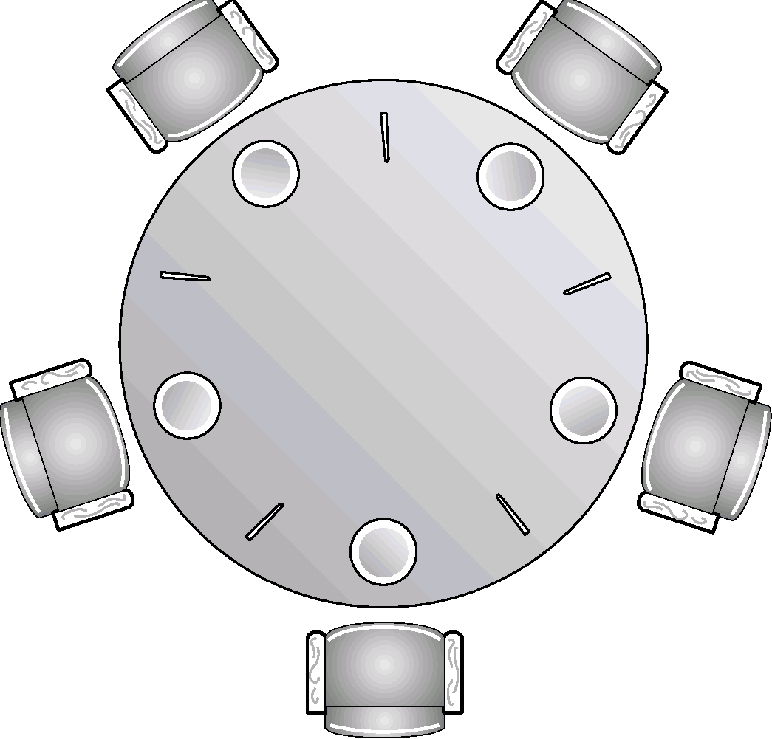
Examples of deadlocks: dining-philosophers
Notes:
10

Slide 11
Examples of deadlocks: file sharing
P₁:
...
Request(D);
Request(T);
...
...
Release(T);
Release(D);
P₂:
...
Request(T);
...
Request(D);
...
Release(D);
Release(T);
Notes:
11

Slide 12
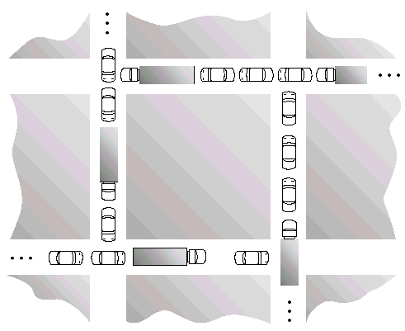
Examples of deadlocks: traffic
Notes:
12

Slide 13
Outline
Why?
The deadlock problem
What?
Modeling
Notes:
13

Slide 14
The resource model
Finite number of serially reusable resources R₁, ..., R_{m}.
Number of units is constant.
No sharing for single unit.
Set of threads T₁, T₂, ..., T_{n}.
Operations on resources:
Request: If request cannot be granted, wait until some other thread releases resource.
Such as sem_wait() in semaphore
Use: Only one thread uses one unit of resource.
Release:
Such as sem_post() in semaphore
Notes:
14

Slide 15
Resource Allocation Graph (RAG)
G = (V, E)
V = {P,R} = vertices
T = {T₁, T₂, ..., T_{n}} : set of threads.
R = {R₁, R₂, ..., R_{m}} : set of resources.
E = edges
Edges represent waiting-for or allocated-to relations.
(T_{i}, R_{j}) in G
Thread T_{i} is waiting for Resource R_{j} (request edge)
(R_{j}, T_{i}) in G
Resource R_{j} is allocated to Thread T_{i} (assignment edge)
T_{i}
R_{j}
T_{i}
R_{j}
Notes:
15

Slide 16
Example of RAG
V = (T = {T₁, T₂}, R = {R₁})
E_{initial} = {(R₁, T₂)}
E_{final} = {(R₁, T₂), (R₁, T₁)}
T₁
T₁
T₁
T₁
R₁
R₁
R₁
R₁
T₂
T₂
T₂
T₂
Request
Acquisition
Release
Notes:
16

Slide 17
Quiz (RAG)
Notes:
17

Slide 18
Solution (RAG)
R₄
T₁
R₁
T₄
T₂
R₃
T₃
R₂
Notes:
18

Slide 19
Necessary conditions for deadlocks
Mutual exclusion:
Threads claim exclusive control of resources that they require (e.g., a thread grabs a lock).
Hold-and-wait:
Threads hold resources allocated to them (e.g., locks that they have already acquired) while waiting for additional resources (e.g., locks that they wish to acquire).
No preemption:
Resources (e.g., locks) cannot be forcibly removed from threads that are holding them.
Circular wait:
There exists a circular chain of threads such that each thread holds one more resources (e.g., locks) that are being requested by the next thread in the chain.
Notes:
19

Slide 20
RAG and deadlocks
Observation 1: If a RAG does not have a cycle, then no process is deadlocked.
Observation 2: If a RAG has a cycle, then a deadlock may exist.
R₁
R₂
R₁
R₂
T₁
T₂
T₃
T₄
T₁
T₂
T₃
T₄
R₃
R₃
cycle, no deadlock
cycle, deadlocked
The existence of cycles in the RAG is necessary but not sufficient for a deadlock.
Notes:
20

Slide 21
Quiz
Any thread is deadlocked? Why?
R₁
R₂
T₁
T₂
T₃
T₄
T₅
R₃
R₄
T4 and T5 are deadlocked.
Notes:
21

Slide 22
Outline
Why?
The deadlock problem
What?
The exact definition
How?
Prevention
Notes:
22

Slide 23
Deadlock prevention
Prevent occurrence of deadlock by preventing occurrence of any one of the 4 necessary conditions for deadlock.
Mutual exclusion
Hold and wait
No preemption
Circular wait
Notes:
23

Slide 24
(1) mutual exclusion
Make resources shareable:
locking cells in spreadsheet instead of locking the whole spreadsheet.
Limitation:
Can we share cell in spreadsheet?
Notes:
24

Slide 25
(2) hold and wait
Requesting resources simultaneously and atomically.
Examples
Thrashing
Dinning philosophers
Notes:
25

Slide 26
Thrashing - Why?
No processes are allocated enough frames
Hold and wait
Possible deadlock
Under page replacement
Move allocation/request edges from one process to another process
Problem can not be solved with regular page replacement policy
Getting worst as more processes are admitted
frames in memory
processes
Notes:
26

Slide 27
Thrashing - How?
Prevent hold/wait
Let some process fully hold enough frames but the others wait
frames in memory
processes
Notes:
27

Slide 28
Dinning philosophers
If anyone wants to eat, make sure both chopsticks are available.
If only one is available, wait.
Don’t pick one and wait for the other.

Slide 29
Limitations
Encapsulation works against us:
It requires us to know when calling a routine exactly which locks must be held and to acquire them ahead of time.
It likely decreases concurrency
All locks must be acquired early on (at once) instead of when they are truly needed.
Notes:
29

Slide 30
(3) no preemption
Cause: we generally view locks as held until unlock is called
Multiple lock acquisition often gets us into trouble because when waiting for one lock we are holding another.
Many thread libraries provide a more flexible set of interfaces to help avoid this situation.
Specifically, a trylock() routine will grab the lock (if it is available) or return -1 indicating that the lock is held right now and that you should try again later if you want to grab that lock.
Notes:
30

Slide 31
(4) circular wait
Impose a total ordering on lock acquisition:
tape drive: order 1
disk drive: order 5
printer: order 12
…
Action:
Request resources in an increasing order.
No circular wait condition can occur.
Notes:
31

Slide 32
Outline
Why?
The deadlock problem
What?
The exact definition
How?
Prevention
Avoidance
Notes:
32

Slide 33
Deadlock avoidance via scheduling
Deadlock prevention
Pass a law against one of four necessary conditions
Problem: low device utilization
Alternative: deadlock avoidance via scheduling
Require some global knowledge of resource usage.
Schedule all requests carefully (maybe delay some requests).
Notes:
33

Slide 34
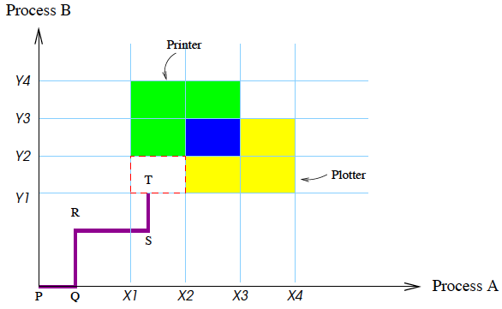
Example
Thread A:
needs the printer from X1 to X3;
needs the plotter from X2 to X4.
Thread B:
needs the plotter from Y1 to Y3;
needs the printer from Y2 to Y4.
Thread B
Thread A

Slide 35
Example (cont’d)
Thread B
If the system ever enters the red-bordered state, it will deadlock.
Later, A requests the plotter and B requests the printer, and both are already assigned.
The entire box is unsafe and must not be entered.
The important thing to see here is that at point T, B is requesting a resource.
The system must decide whether to grant it or not.
If the grant is made, the system will enter an unsafe region and eventually deadlock.
To avoid the deadlock, B should be suspended until A has requested and released the plotter.
Thread A
Notes:
35

Slide 36
The Banker’s algorithm (Dijkstra, Haberman)
Have every thread declare its maximum resource requirements (i.e. maximum number of units required for each resource).
Whenever thread requests resources, determine if granting the request at this time leaves system in a safe state (no potential deadlock) .
If not, delay the request.
Notes:
36

Slide 37
Outline
Why?
The deadlock problem
What?
The exact definition
How?
Prevention
Avoidance
Detection and recovery
Notes:
37

Slide 38
Deadlock detection & recovery
Deadlock prevention and avoidance are cautious approaches.
May overly reduce resource utilization.
Alternative
Periodically analyze RAG, detect deadlocks, and initiate recovery.
Advantages:
A priori knowledge of resource requirements not needed.
Higher resource utilization
Disadvantages:
Cost of recovery
Notes:
38

Slide 39
One more thing about deadlock: the engineer’s approach
Q: Why not ignore deadlocks altogether?
The Ostrich Algorithm: pretend there is no problem
Deadlocks in Unix:
Process table: size limits total number of processes
i-node table: size limits the number of open files.
Most users prefer an occasional deadlock to a rule that unduly restricts them.
Notes:
39

